Slide 1

MVP – DUT ASSIST
XBCAD7319 – XBCAD7329

Slide 2
AGENDA
Introduction
Problem Statement
MVP Scope
MVP Demonstration
Next Steps
Closing

Slide 3
Introduction
The Minimum Viable Product (MVP) for DUT Assist—a solution designed to revolutionize the way student queries are addressed and support requests at DUT.
DUT has always been committed to providing the best possible educational experience for students. As part of ongoing efforts to enhance student satisfaction and streamline administrative processes, we embarked on a journey to create a tailored solution that directly addresses the needs of students. In our increasingly digital world, students are looking for efficient and user-friendly ways to seek assistance and get answers to their questions. DUT Assist represents the response to this challenge. This MVP marks the initial step in this transformation.
We believe that DUT Assist will not only improve the student experience but also empower staff members to better serve the student community. It's a testament to their commitment to innovation and dedication to delivering practical solutions.

Slide 4
Problem Statement
At DUT, the process of addressing and resolving student queries and support requests has become increasingly cumbersome and less efficient. The current system relies heavily on manual interventions, email correspondence, and dispersed communication channels, leading to several critical issues:
Lack of Centralized Tracking: There is no centralized system for tracking and managing student inquiries, making it challenging to ensure timely responses and resolution.
Reduced Student Satisfaction: Prolonged response times and difficulties in tracking the status of queries have led to declining student satisfaction and frustration with the support services provided.
Limited Visibility: Administrators and support staff lack a comprehensive view of student issues, hindering their ability to identify recurring problems, trends, or opportunities for process improvement.

Slide 5
Problem Statement
To address these challenges, DUT recognizes the urgent need for a modernized and centralized Student Ticketing System. This system aims to provide students with a streamlined platform to submit queries and requests while empowering staff with efficient tools for tracking, managing, and responding to these inquiries. The objective is to enhance the overall student experience, optimize administrative processes, and foster a more responsive and proactive support ecosystem at DUT.

Slide 6
MVP Scope – Sprint 1
User Registration and Authentication:
Allow students and staff to register for accounts.
Implement a secure login/authentication system.
Ticket Submission:
Create a user-friendly form for students to submit support tickets.
Include fields for ticket title, category (e.g., academic, technical, administrative), and a detailed description of the issue.
3. Basic Ticket Management:
Allow support staff to assign tickets to specific departments or individuals responsible for resolving them.
Implement basic status updates (e.g., changing a ticket's status from open to in progress and from in progress to resolved).

Slide 7
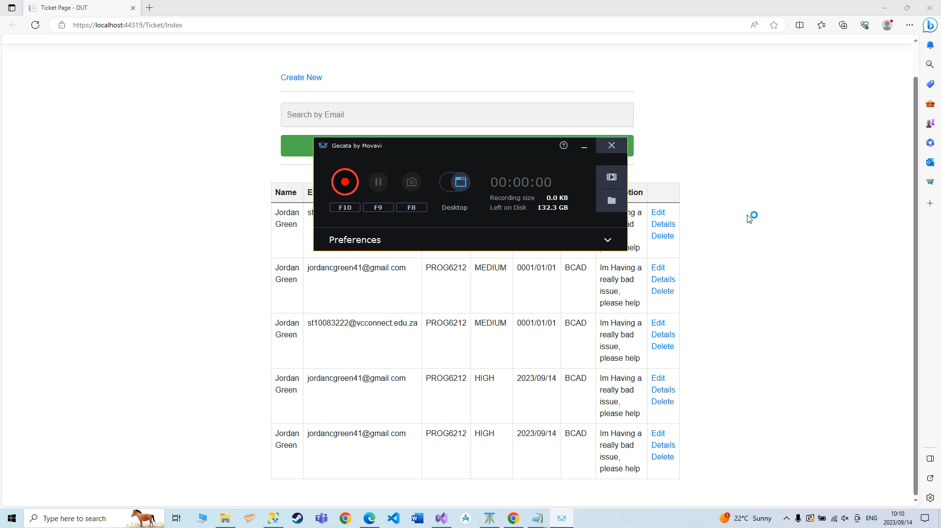
MVP Demo
A short clip of the progress so far – press play

Slide 8
Next Steps
User Testing and Feedback: Gather feedback from students and staff who use the MVP. Understand their experiences and any issues they encounter. Use this feedback to make improvements and prioritize necessary changes.
Bug Fixing and Quality Assurance: Identify and address any bugs, glitches, or usability issues that may have surfaced during Sprint 1. Ensure that the system is stable and reliable.
Enhanced Ticket Management: Expand the ticket management features to include more advanced functionalities, such as assigning tickets to specific individuals or teams, setting priorities, and implementing due dates.
Communication Enhancements: Improve communication channels within the system. Consider adding features like in-app messaging or chat functionality to facilitate real-time interactions between students and support staff.
Integration with Existing Systems: Integrate the ticketing system with other relevant university systems, such as student databases, CRM systems, or knowledge bases, to provide a seamless experience and access to additional resources

Slide 9
Closing
In closing, the presentation of our Minimum Viable Product for DUT Assist marks an important milestone in our journey to enhance the student support experience at DUT. We believe that this system has the potential to streamline and simplify the process of addressing student queries, providing efficient and responsive support, and ultimately improving the overall student experience. Our commitment to innovation and our dedication to ensuring that DUT remains at the forefront of educational excellence drive us forward.

